Slide 1
Blind test of Plasma samples using exosome count
Pres. Nareg Ohannesian
10-13-2021

Slide 2
Experimental Details
Used samples: 072; 991; and 996.
Plasma volume: 20 µl.
Type of Cancer: unknown.
Concentration: unknown.
Size Distribution: unknown.
Experimental duration: 60 min.
Antibody used: CD9, CD81, and CD63.

Slide 3

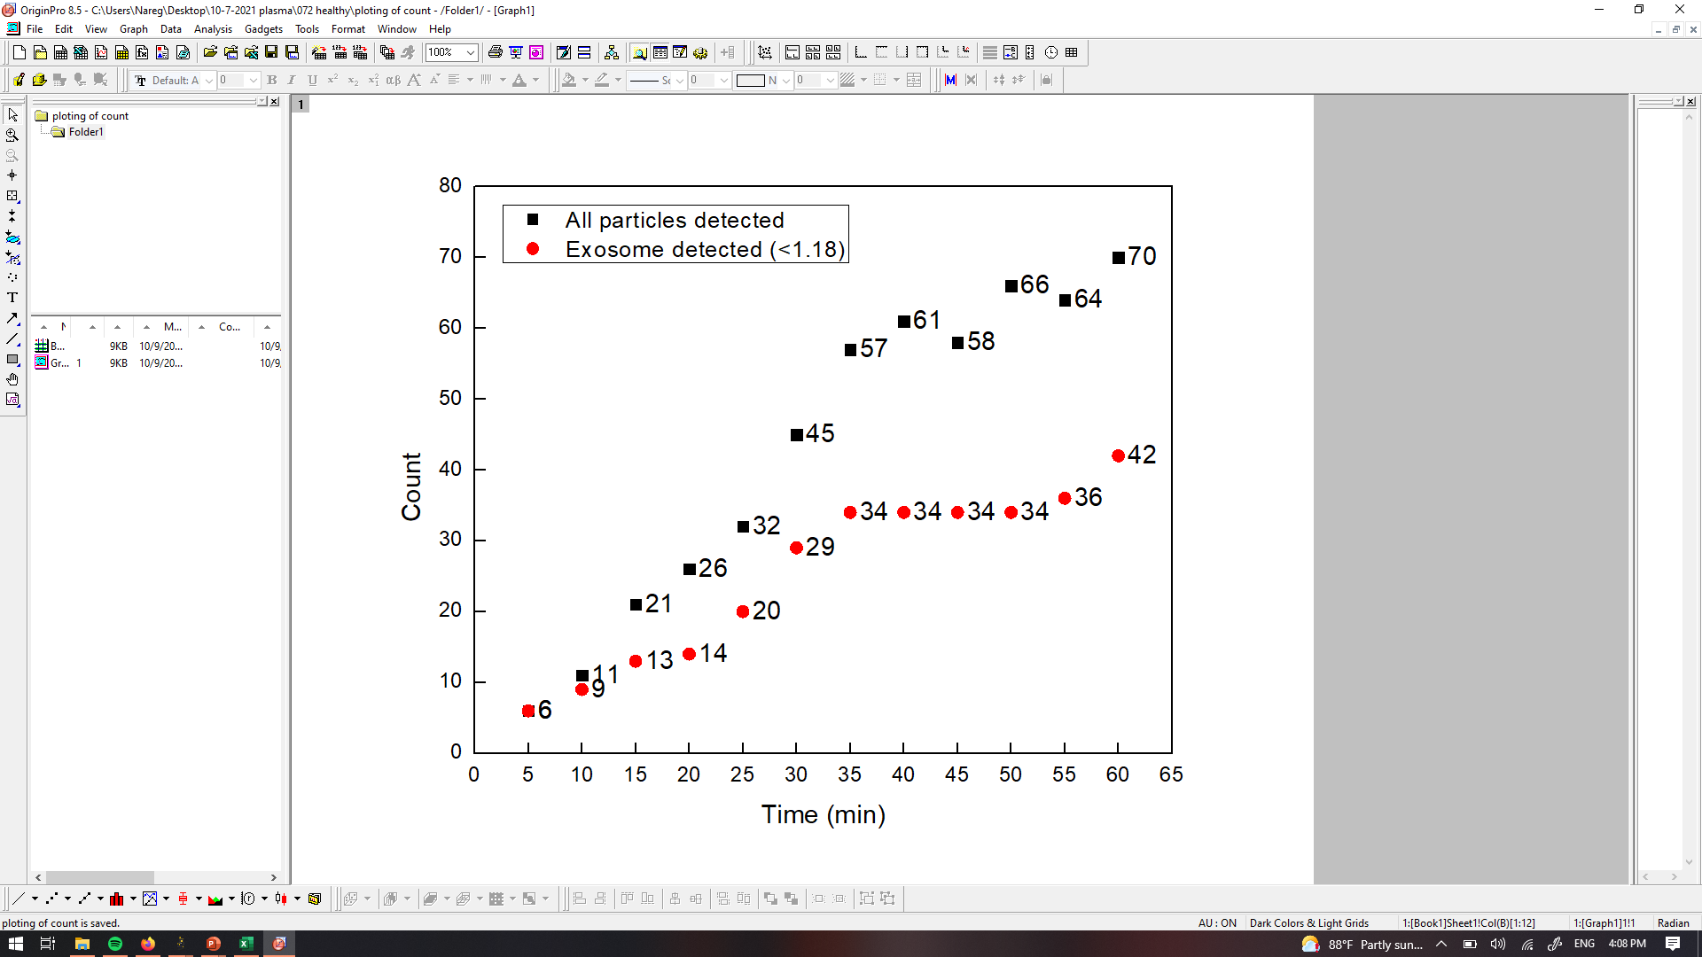
PANRORAMA of Plasma Sample 072
Time: 10 min
Time: 20 min
Time: 30 min
Particle count at 5 min intervals
Time: 40 min
Time: 50 min
Time: 60 min
Scale bar: 10 µm

Slide 4
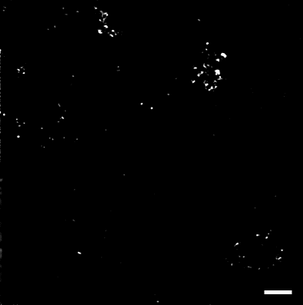
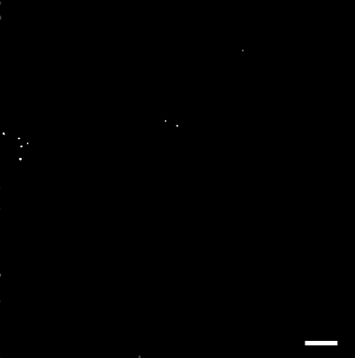
PANRORAMA of Plasma Sample 072
Time: 60 min
Count: 70
Time: 60 min wash
Count: 8
Note: No response to miRNA-21 mb
Scale bar: 10 µm

Slide 5
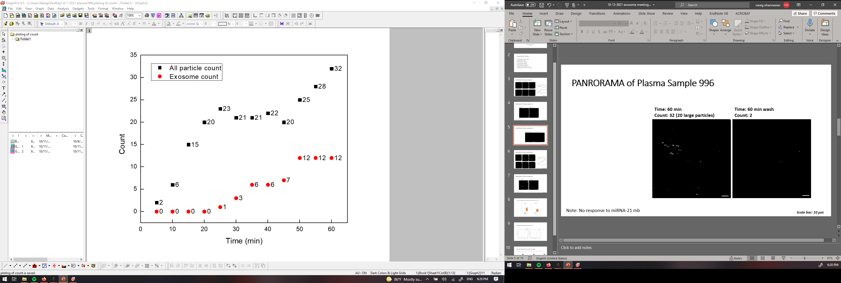
PANRORAMA of Plasma Sample 996
Time: 60 min
Count: 32
Time: 60 min wash
Count: 2
Particle count at 5 min intervals
Note: No response to miRNA-21 mb
Scale bar: 10 µm

Slide 6
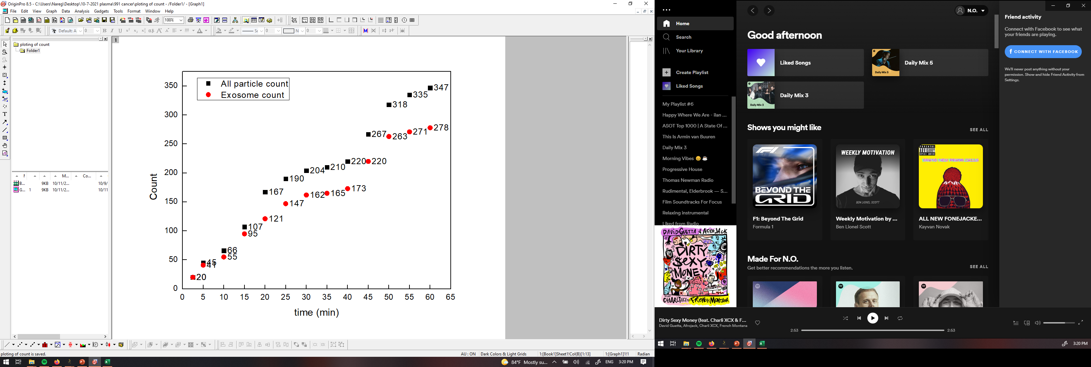
PANRORAMA of Plasma Sample 991
Time: 10 min
Time: 20 min
Time: 30 min
Particle count at 5 min intervals
Time: 40 min
Time: 50 min
Time: 60 min
Scale bar: 10 µm

Slide 7
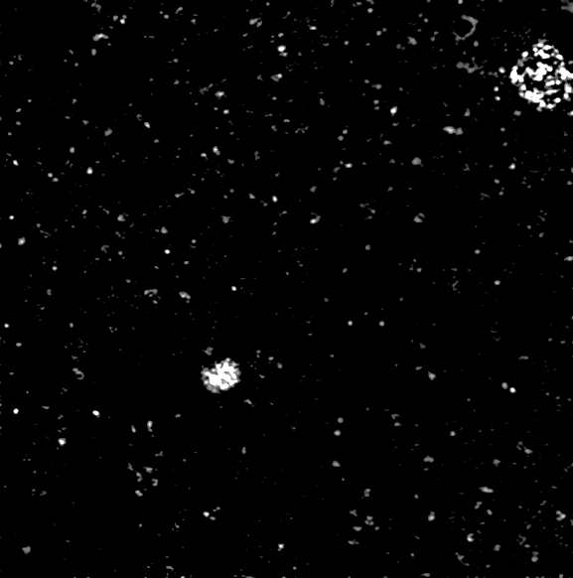

PANRORAMA of Plasma Sample 991
Time: 60 min
Count: 347
Time: 60 min wash
Count: 120
Note: 8 particles with miRNA response.
Scale bar: 10 µm

Slide 8
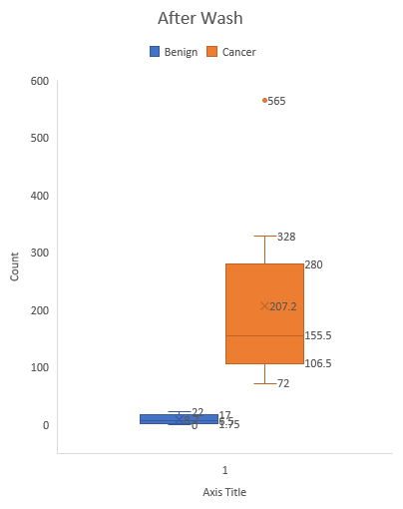
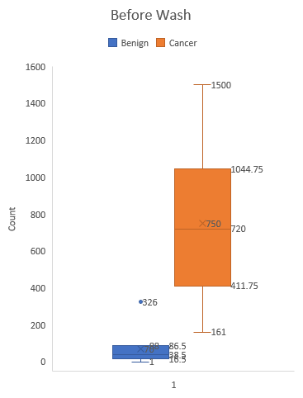
Count of particles/exosomes before and after wash
Plasma Sample | Before Wash (Total) | After Wash | Type
072 | 42 (70) | 8 | Healthy
996 | 12 (32) | 2 | Healthy
991 | 278 (347) | 120 | Cancer

Slide 9
Prediction?!
Healthy | Cancer
072 | 002
996 | 991
087 | 1003
161 | 1001

